Slide 1


{team 7}: {Gitaxian Probe}
{Raksha Rehal & Nicholas Tillo}
Notes:
Hello, This is group 7’s, and heres our project Gitaxian Probe

Slide 2
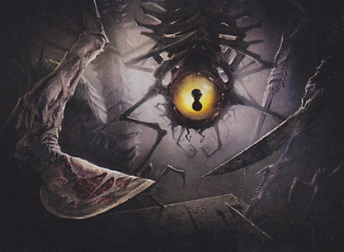
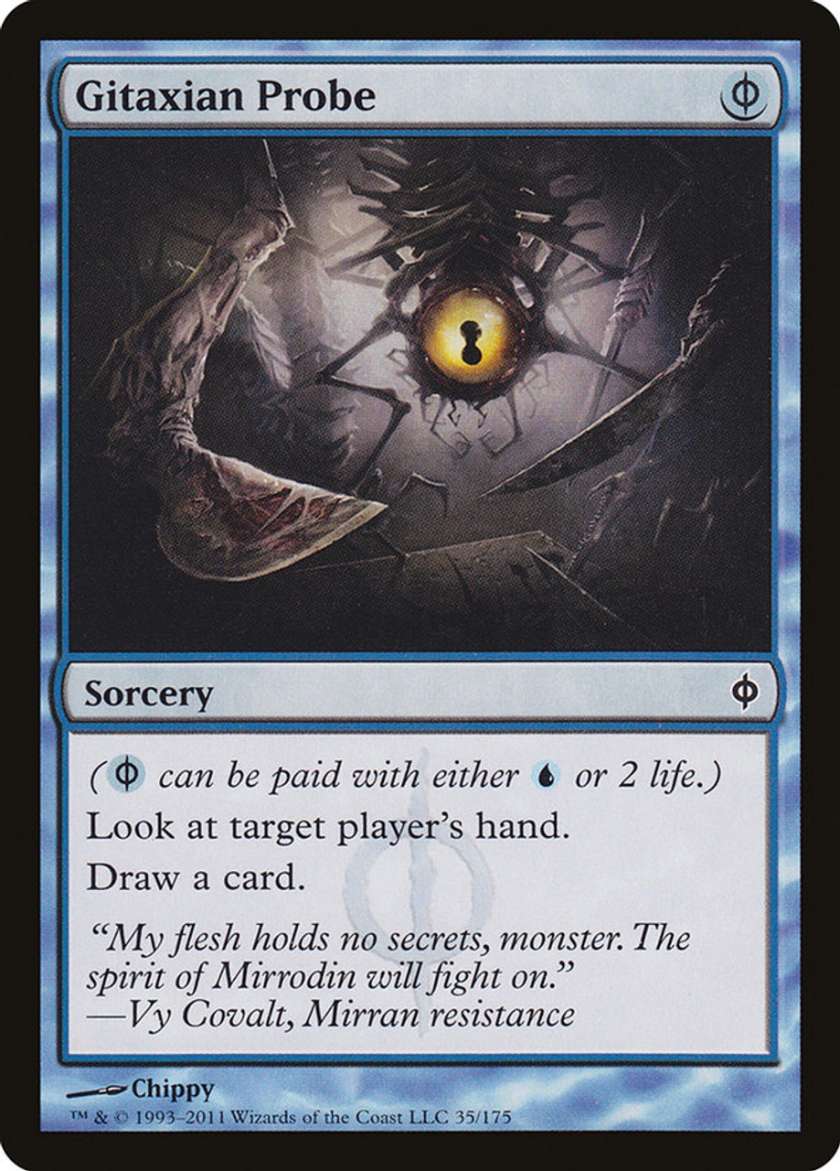
Summary
Our project is an exploration of the techniques of artificial intelligence and its ability to be used to optimize and analyze the trading card game Magic The Gathering. The goal is to optimize play and streamline feedback during games to allow new players to better understand correct lines of play.
Notes:
Our project is an exploration of the techniques of artificial intelligence and its ability to be used to optimize and analyze the trading card game Magic The Gathering. Named after the infamous card, Gitaxian Probe’s ultimate goal is to provide a new way to gather information about how magic the gathering should be played. With this information we can optimize play for the purpose of giving streamlined feedback to new players allowing them to better understand correct lines of play.

Slide 3
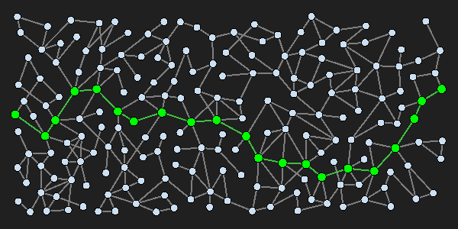
Planning – Optimal Play
What is the most optimal sequence of moves that will result in a winning outcome?
Incredibly Large Branching Factor
Requires a Step-By-Step approach.
Simplified Model
Assumed Theoretical Control to be able to model multiplayer games.
Approach:
Take a snapshot of the game state.
Run planning algorithm using that snapshot.
For the next turn, repeat.
Notes:
The question we are attempting to solve with a planning approach is: What is the most optimal sequence of moves that will result in a win?
Because of the thousands of decisions you make on any given turn of magic, there is an incredibly Large Branching Factor. Our computers would explode before reaching any meaningful conclusion. Thus this problem requires a Step-By-Step approach, and also requires the model to be much more simplified, and thus we will restrict down the possible cards down to a reasonable domain. Our planned approach is to use this assumed theoretical control to model the two-player nature of magic. We will iteratively generate the best moves for each player, step by step:
We will be taking a snapshot of the game state, including hand, available mana, owned creatures, opposing creatures, everything that is available at the moment. Run a planning algorithm using that snapshot that would describe “if nothing were to change, how do we win or more likely, how do we get to a better state than we are currently in”. Then take that plan and run the first step of it. Once the results have been settled we, then repeat in order to create a a full tree of decisions until the game is won.

Slide 4
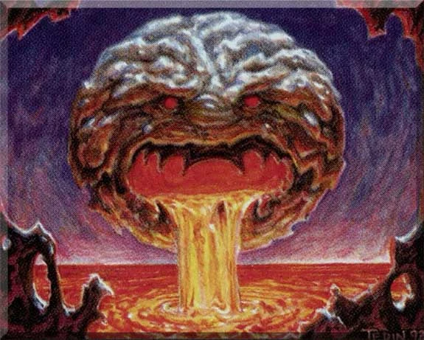
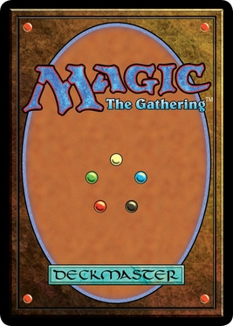
Probabilistic Inference – Probability To Win
What should I prioritize in this game?
Variables will be gathered from looking at previous tournament play games to find what states lead to wins.
Could be used as a heuristic for the planning algorithm.
Answers Key Questions:
What is the most important factor to winning.
Notes:
The question we are attempting to solve with a Bayesian approach is “What should I prioritize in this game, what resource is the most important?”. We will take a look at how all the variables in the game affect each other. Which Variables we choose will be gathered from looking at previous tournament play games to find what states lead to wins. Possible variables can be, cards in hand, creatures on board, colors in deck, cards drawn in the game. All of these variables have interconnected relationships with each other. And therefore we can map it as a network of possibilities.
We can eventually answer questions like:
What is the most important factor to winning?

Slide 5
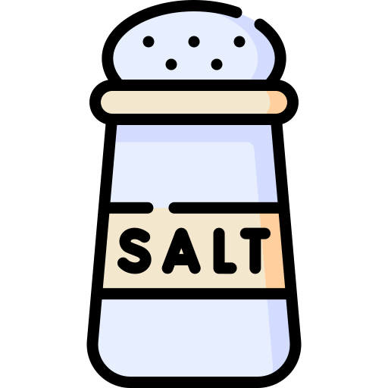
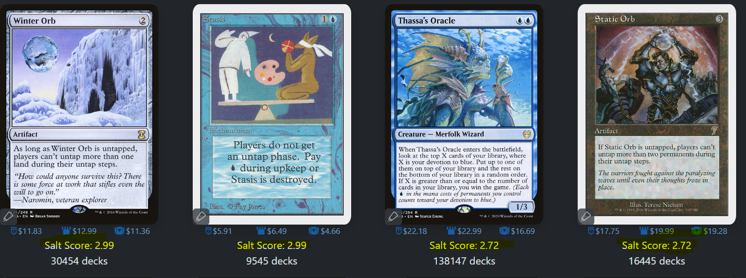
Deep Learning – Salt Score Analyzing
Using the variety of information stored on a MTG card, train a deep-learning model to estimate the "salt score" of MTG cards.
The community voted “How much do I hate playing against this card” value
Variables will be values on the card, mana cost, text on card, ETC
Approach:
Gather required resources, labelled dataset, and a testing dataset,
Use one of the python libraries to generate the model.
Run it against testing data to validate performance with new information
Notes:
The question we are attempting to solve with a Deep Learning approach is “how mad will this proposed card make people”
Using the variety of information stored on a MTG card we will attempt to train a deep-learning model to estimate the "salt score" of MTG cards. The salt score of a card is the community voted “How much do I hate playing against this card” value and can be found on the website EDHREC.
We will train this deep learning model on the values on the card, Things like mana cost, text on card, power, toughness ETC. These variables will then all be combined by our project to create a model that is capable of taking in new information, and attempting to give it a fitting salt score.
Our planned approach is to:
Gather required resources from online sources in order to create a labelled/supervised dataset, we will then use this dataset in order to train a deep learning model to recognize what makes a card salty or not.
This will utilize of the python libraries to sort and manipulate the data, and a separate python library to train the model.

Slide 6
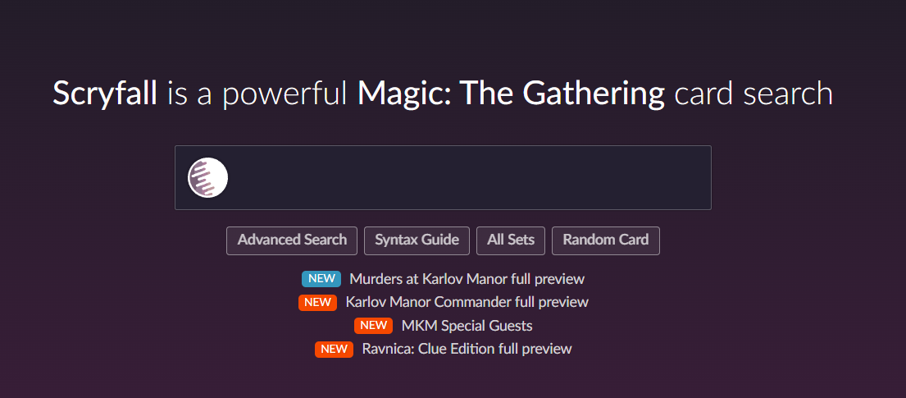
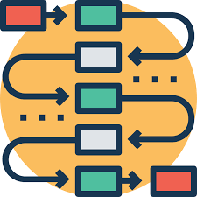

Planned Implementation
Python For Implementation
PDDL for Planning.
PyTorch, Keras, or TensorFlow for Deep learning
NumPy or PyMC3 for probabilistic networks.
Universally Required Python Libraries: NumPy,
Data required:
Card data will be gathered for free from the Scryfall website as separate JSON files per card, processed in python.
Notes:
The main language we are going to be using in python. We will be using the python libraries of NumPy or PyMC3 for probabilistic networks and PyTorch, Keras, or TensorFlow for Deep learning. Planning is different, using PDDL and the methods taught in class.
For all of the potential projects, they require a lot of data for understanding and training models. Thus we will gather all the card data from every card printed from the website Scryfall, which stores cards as JSON files that can be then processed in python for readability

Slide 7
End

